Slide 1

DIGITAL IMAGE FUNDAMENTALS
Understanding Pixel Representation, Spatial Resolution,
Intensity Resolution, and Grayscale Images
TECHNICAL PRESENTATION
CO1-AT3 ITA 0515
PRESENTED BY
VARSHA R 192421045
VIDDHIYASHREE 192421188
K Sreelatha 192425248
K Amrutha 192425366

Slide 2
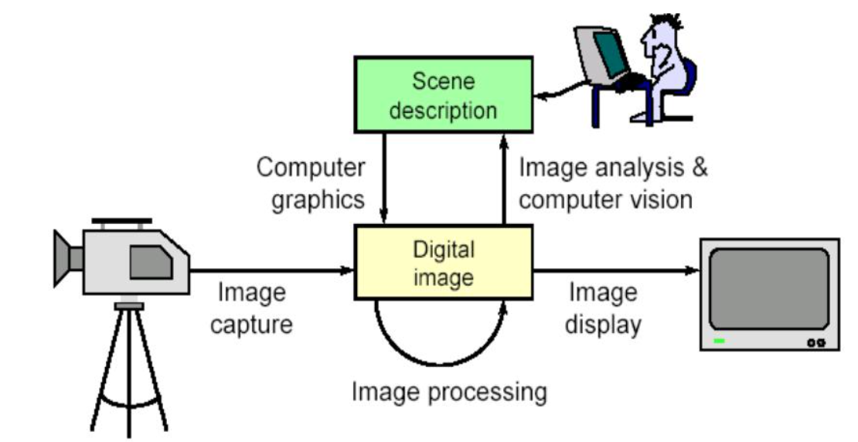
INTRODUCTION
- A digital image is a visual representation stored in digital form.
- It consists of pixels arranged in rows and columns.
- Used in photography, medical imaging, satellite imaging, and computer vision.
- Image quality depends on resolution and intensity levels.

Slide 3
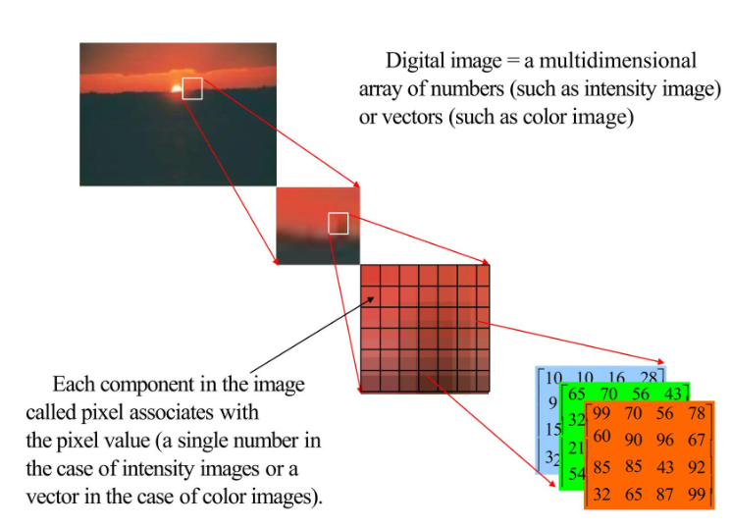
OBJECTIVES
- Understand digital image fundamentals.
- Explain pixel representation.
- Study spatial and intensity resolution.
- Understand grayscale images.
- Identify common image quality issues.

Slide 4
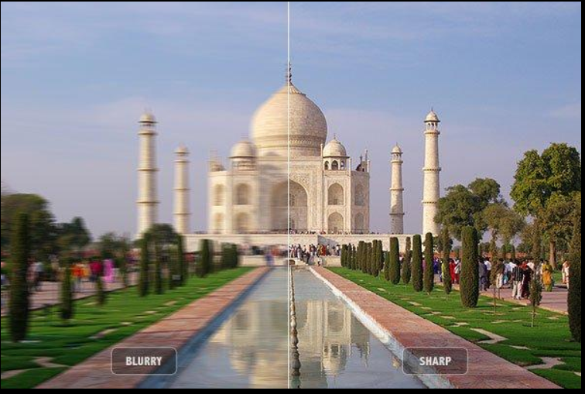
PROBLEM STATEMENT
- Low spatial resolution causes blurred images.
- Insufficient intensity resolution reduces detail.
- Noise and distortion affect clarity.
- Poor image quality impacts analysis and decision making.
Problem: How can image quality be represented and maintained effectively

Slide 5
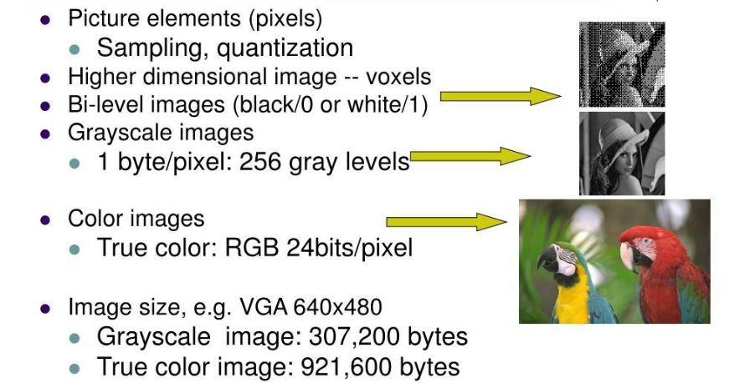
DIGITAL IMAGE FUNDAMENTALS
Pixel Representation: Smallest unit of an image.
Spatial Resolution: Number of pixels in an image.
Example: 1920 × 1080.
Intensity Resolution: Number of brightness levels.
Example: 8-bit = 256 gray levels.
Grayscale Image: Values range from 0 (black) to 255 (white).

Slide 6
CONCLUSION
- Pixels form digital images.
- Spatial resolution determines image detail.
- Intensity resolution determines brightness accuracy.
- Grayscale images are important in image processing.
- These concepts are fundamental to computer vision.

Slide 7


